Slide 1
UNIT -II
What is knowledge representation?
Knowledge representation and reasoning (KR, KRR) is the part of Artificial intelligence which concerned with AI agents thinking and how thinking contributes to intelligent behavior of agents.

Slide 2
What to Represent:
Object: All the facts about objects in our world domain. E.g., Guitars contains strings, trumpets are brass instruments.
Events: Events are the actions which occur in our world.
Performance: It describe behavior which involves knowledge about how to do things.
Meta-knowledge: It is knowledge about what we know.
Facts: Facts are the truths about the real world and what we represent.
Knowledge-Base: The central component of the knowledge-based agents is the knowledge base. It is represented as KB. The Knowledgebase is a group of the Sentences (Here, sentences are used as a technical term)

Slide 3
Types of knowledge
1. Declarative Knowledge:
Declarative knowledge is to know about something.
It includes concepts, facts, and objects.
It is also called descriptive knowledge and expressed in declarativesentences.
It is simpler than procedural language.

Slide 4
Types of knowledge
Procedural Knowledge
It is also known as imperative knowledge.
Procedural knowledge is a type of knowledge which is responsible for knowing how to do something.
It can be directly applied to any task.
It includes rules, strategies, procedures, agendas, etc.
Procedural knowledge depends on the task on which it can be applied.

Slide 5
Types of Knowledge
3. Meta-knowledge:
Knowledge about the other types of knowledge is called Meta-knowledge.
4. Heuristic knowledge
Heuristic knowledge is representing knowledge of some experts in a filed or subject.
Heuristic knowledge is rules of thumb based on previous experiences, awareness of approaches, and which are good to work but not guaranteed.
5. Structural knowledge:
Structural knowledge is basic knowledge to problem-solving.
It describes relationships between various concepts such as kind of, part of, and grouping of something.
It describes the relationship that exists between concepts or objects.

Slide 6
CATEGORIES AND OBJECTS
In this chapter we address the question of what content to put into such an agent's knowledge base-how to represent facts about the world.
The organization of objects into categories is a vital part of knowledge representation.
There are two chalices for representing categories in first-order logic: predicates and
objects.

Slide 7
CATEGORIES AND OBJECTS………
Categories serve to organize and simplify the knowledge base through inheritance.
Subclass relations organize categories into a taxonomy, or taxonomic hierarchy
First-order logic makes it easy to state facts about categories, either by relating objects to categories or by quantifying over their members:
An object is a member of a category. For example:
BB9 E Basketballs
A category is a subclass of another category. For example:
Basketballs C Balls
All members of a category have some properties. For example:
x E Basketballs + Round (x)
Members of a category can be recognized by some properties. For example:
Orange (x) A Round (z) A Diameter(x) = 9.5" A x E Balls + x E Basketballs
A category as a whole has some properties. For example:
Dogs E DomesticatedSpecies

Slide 8
CATEGORIES AND OBJECTS………..
We say that two or more categories aredisjoint if they have no members in common.
we say that males and females constitute an exhaustive decomposition of the animals.
A disjoint exhaustive decomposition is known as a partition. The following examples illustrate these three concepts:
Disjoint ({Animals, Vegetables))
ExhaustiveDecomposition({Americans, Canadians, Mexicans),NorthAmericans)
Partition ({Males, Females), Animals)

Slide 9
CATEGORIES AND OBJECTS………
Categories can also be defined by providing necessary and sufficient conditions for membership. For example, a bachelor is an unmarried adult male:
x E Bachelors -> Unmarried(x) A x E Adults A x E Males .
Physical composition :PartOf relation to say that one thing is part of another
The PartOf relation is transitive and reflexive; that is,
PartOf(x, Y) A PartOf ( y , z) + partof (x, z) .
Part Of ( x , x )
Categories of composite objects are often characterized by structural relations among parts
It is also useful to define composite objects with definite parts but no particular structure.
Bunch:
-defines the composite objects.
x E s -> PartOf (x, BunchOf is)) .

Slide 10
ACTIONS, SITUATION AN D EVENTS
actions are logical terms such as Forward and Turn(Right).
Situations are logical terms consisting of the initial situation (usually called So) and all situations that are generated by applying an action to a situation. The function Result(a, s) (sometimes called Do) names the situation that results when action a is executed in situation s.
Fluents are functions and predicates that vary from one situation to the next, such as the location of the agent.

Slide 11
Logical Agents
An Agent can represent knowledge of its world, its goals and current situation.
LA ha a collection of sentences in logic
By using Logical sentences the agents decides what to do by inferring knowledge(conclusions).
Conclusions is achieved by certain action or set of actions, is appropriate to achieve its goals.

Slide 12
Knowledge Base Agents
The central component of a knowledge-based agent is its knowledge base, or KB.
KB Contains a set of sentences in a formal Language.
Sentences are expressed using a knowledge representaion language.
Two generic functions
TELL- add new sentences (facts) to the KB
“Tell it what it needs to know”
ASK-query what is known from the KB
“Ask what to do next”

Slide 13
Knowledge Base Agents
function KB-AGENT(percept)returns an action
static: KB, a knowledge base
t, a counter, initially 0, indicating time
TELL(KBM, AKE-PERCEPT-SENTENCE(percept)
A
ction <- AsK(KB, MAKE-ACTION- QUERY(^))
TELL(KB,MAKE-ACTION-ENTENCEt)(action,t))
t->t+1
return action

Slide 14
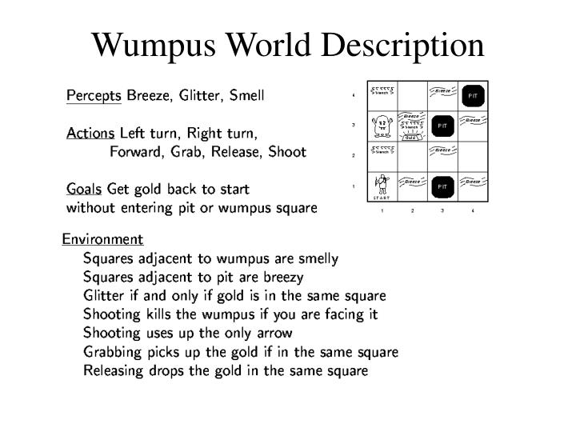
THE WUMPUS WORLD The wumpus world is a cave consisting of rooms connected by passageways. Lurking somewhere in the cave is the wumpus, a beast that eats anyone who enters its room. The wumpus can be shot by an agent, but the agent has only one arrow. Some rooms contain bottomless pits that will trap anyone who wanders into these rooms (except for the wumpus, which is too big to fall in). feature of living in this environment is the possibility of finding a heap of gold

Slide 15
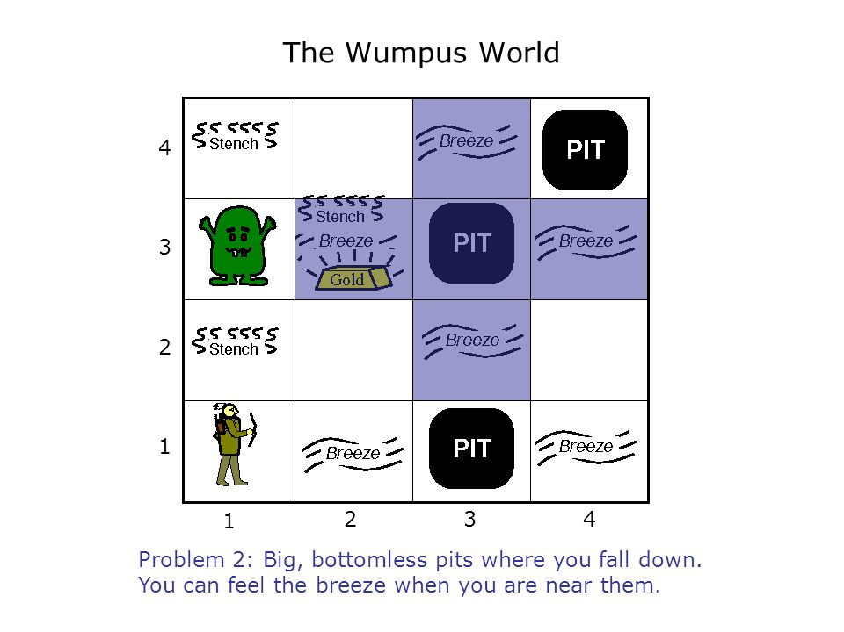

Slide 16
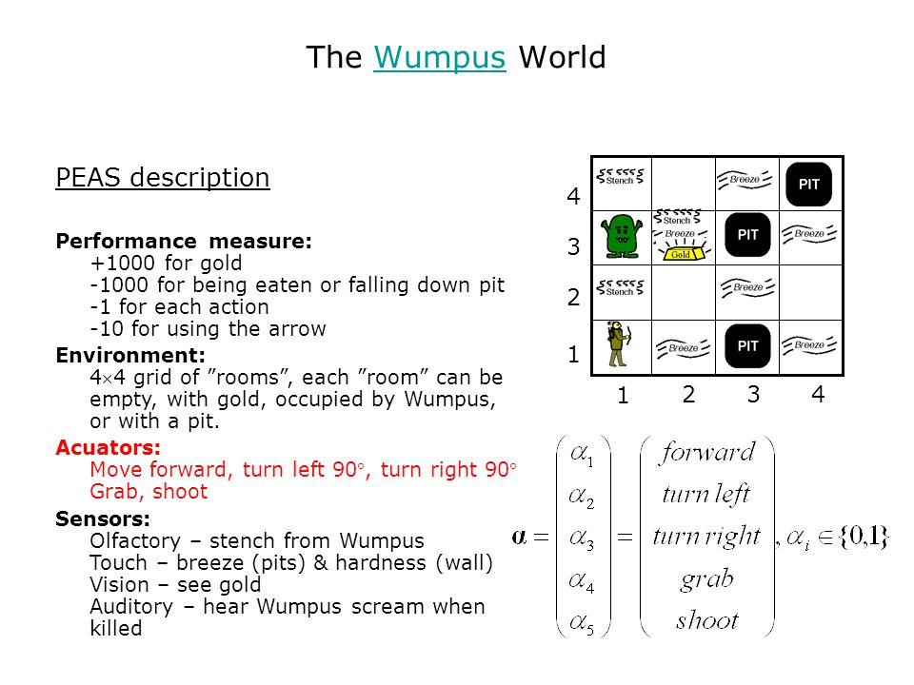

Slide 17
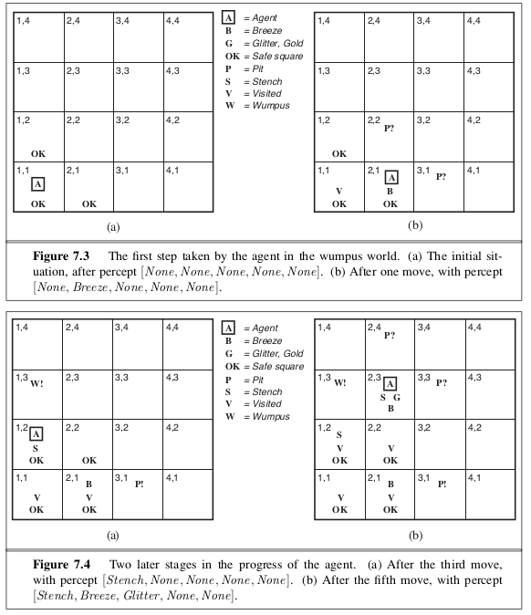
INITIAL STEP

Slide 18
Propositional Logic
Here the statements are made of propositions.
The propositional logic is also called as boolean logic
The sentence /statement is declarative which is either true or false but cannot be both.
Question,opinion and comma are not allowed in this logic
Eg.Students are studying in college(True proposition)
5+3=8(True proposition)
What is your name?(not accepted)
Some students are intelligent(false proposition)

Slide 19
Propositional Logic-syntax
Syntax-defines the allowable sentences.
The atomic sentences-the individual syntactic elements-consist od a single proposition symbol.
Each such symbol stands for propositional that can be true or False.
We wil use uppercase names for symbols:P,Q,R and so on.
For eg
W _{1,3} stand for the proposition that the wumpus is in [1,3]

Slide 20
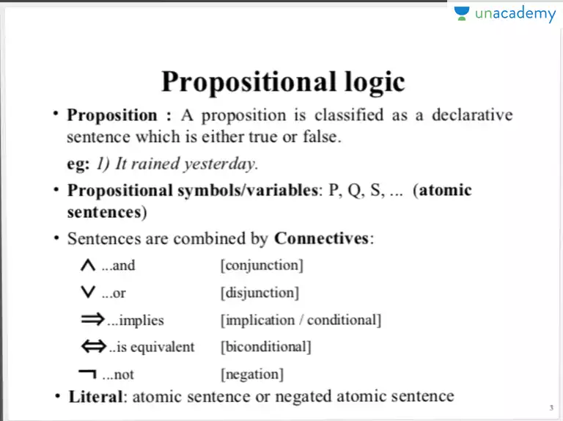
Complex sentences logical operators

Slide 21
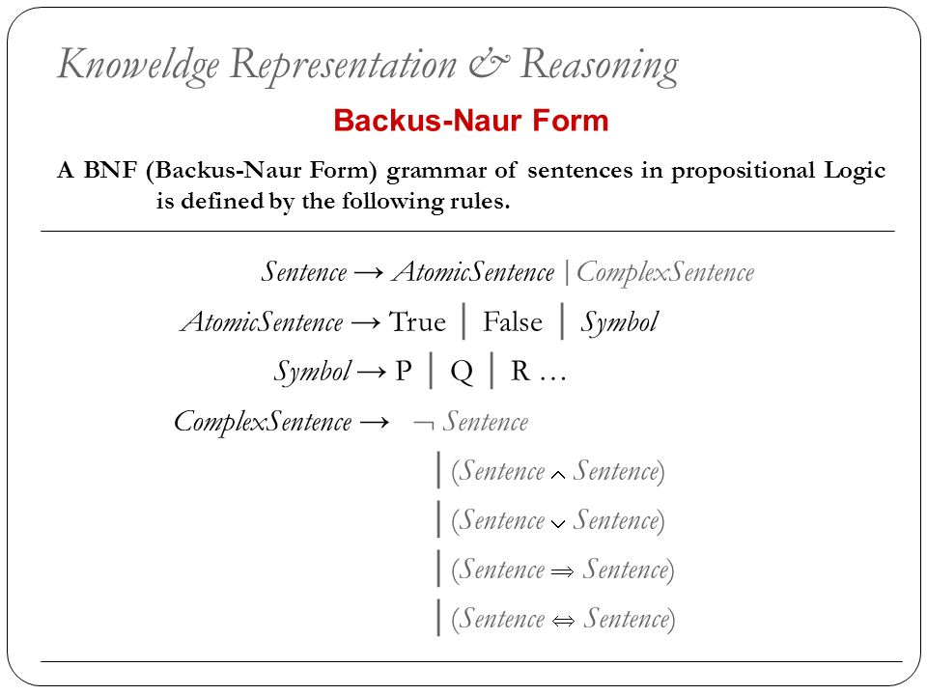
A Formal Grammar of Propositional Logic

Slide 22
Propositional Logic-semantics
The semantics define the rules for determining the truth of a sentence w.r.to a particular model.
In propositional logic model simply fixes the truth value true or false-for every propositional symbol.
m1=(P1,2=false,P2,2=false,P3=true)
The semantics for this logic must specify how to compute the truth value of any sentence given a model.
This is done recursively.
All sentences are constructed form atomic and the five connectives.

Slide 23
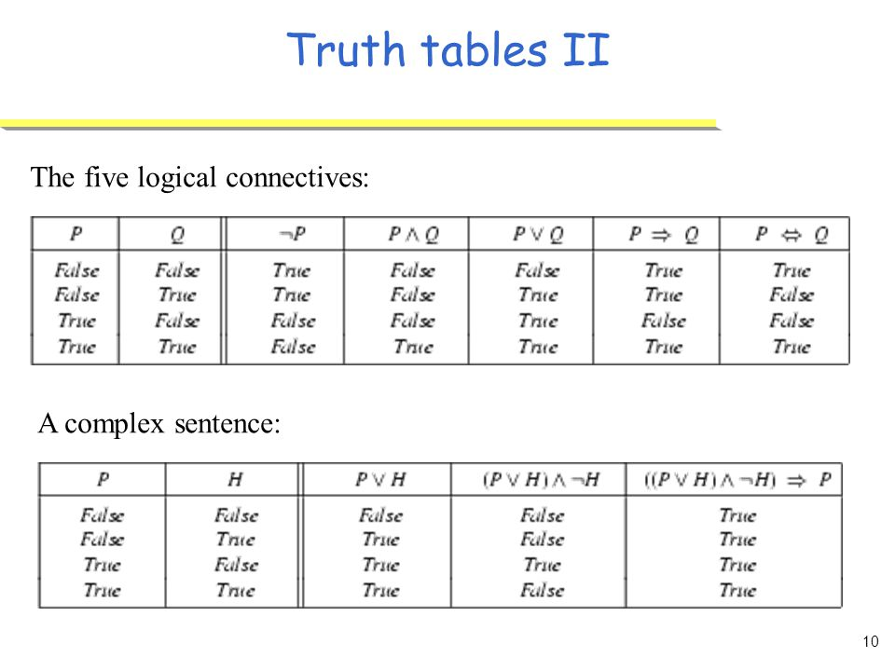

Slide 24
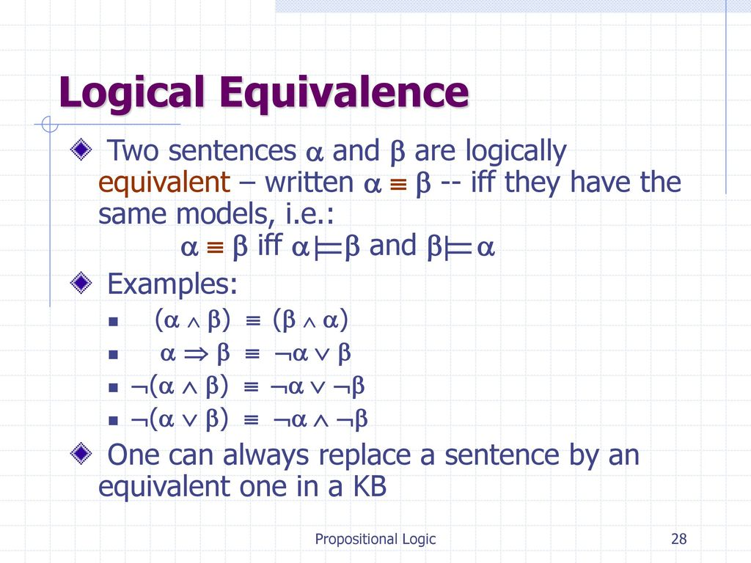
Inferences ……….
Equivalence, validity, and satisfiability
Pg :210

Slide 25
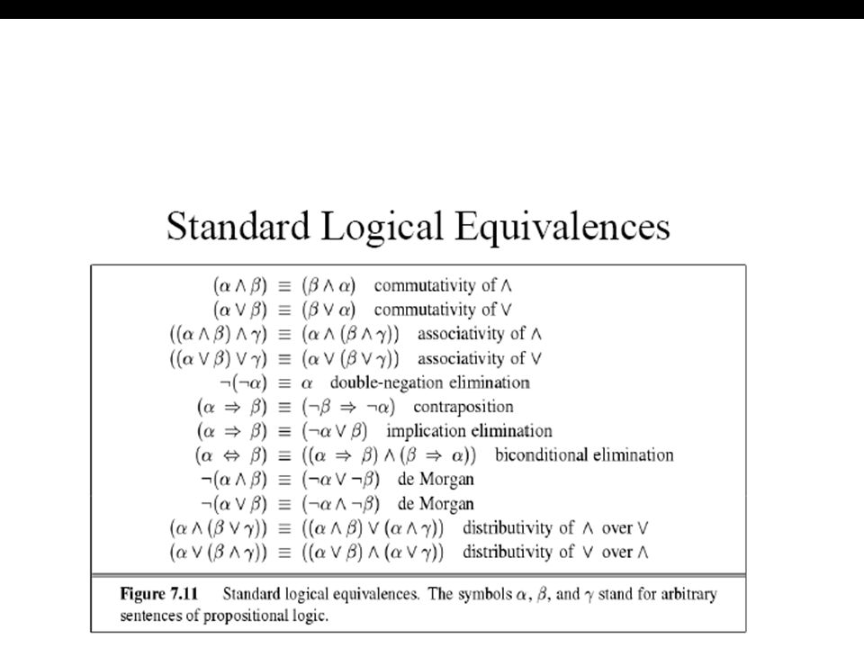

Slide 26
Reasoning pattern in propositional logic
This section covers standard patterns of inference that can be applied to derive chains of conclusions that lead to the desired goal. These patterns of inference are called inference rules.

Slide 27
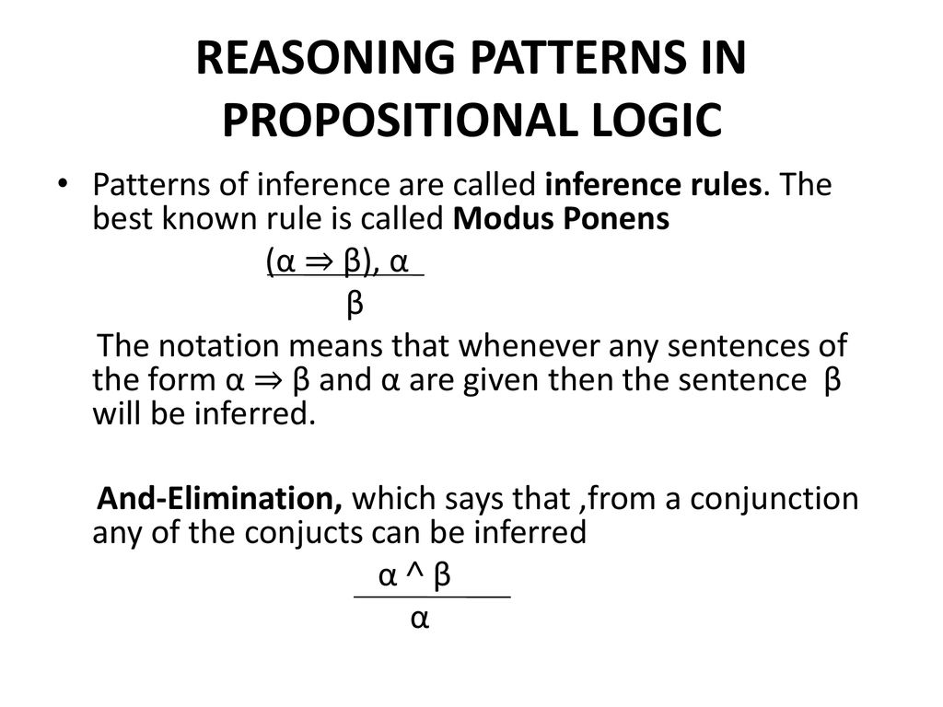

Slide 28
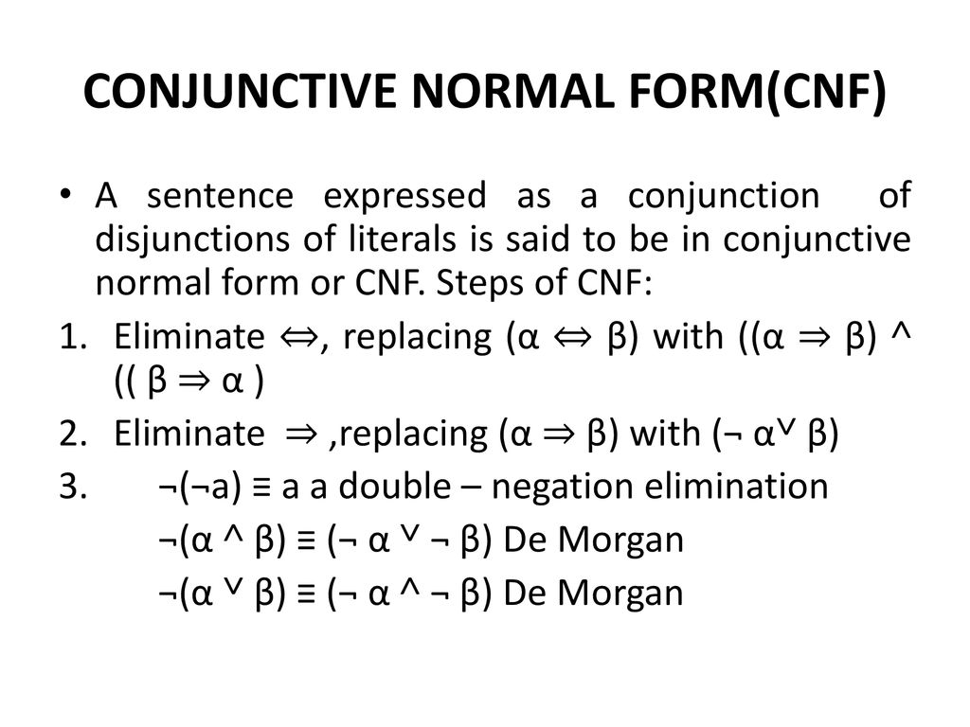

Slide 29
First Order logic/Predicate Logic
Its like a natural language has well defined syntax and semantics.
It assumes the world contains
Object:people,houses,numbers,colors,baseball games, wars………..
Relations:red,round,prime,brother of, bigger than………
Functions: father of best friend, one more than, plus……

Slide 30
Properties of FOL
It has the ability to represent facts about some or all of the objects and relations in the universe.
Represent law and rules extracted from the real world.
Useful language for maths, philosophy and AI
Represent facts in realistic manner rather than just true /false.

Slide 31
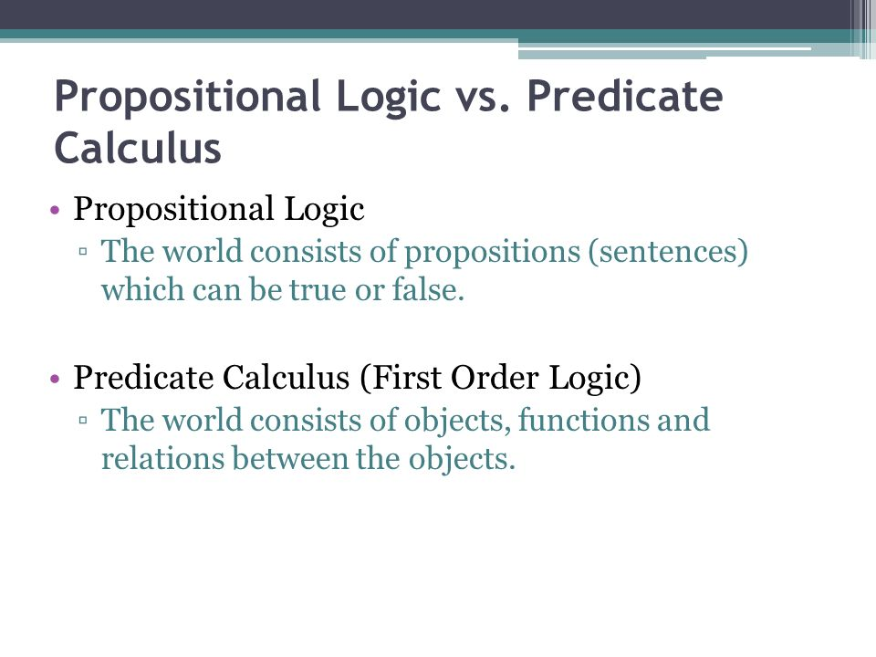

Slide 32
Atomic sentences
Atomic sentences=predicate(term1……..termn)
Term=function(term1,,,,,,,,,termn)or constant or variable
Example:
Brother(Richard, John).

Slide 33
Complex sentences
It is made from atomic sentences using five Logical connectives
S1 and S2 are two atomic statements then (BCF)
Truth in FOL
Sentences are true with respect to a model and an interpretation.
Model contains objects(domain elements) and relations among them.
Interpretation specifies
Constant->objects
Predicate->Relations
Function->Functional relations

Slide 34
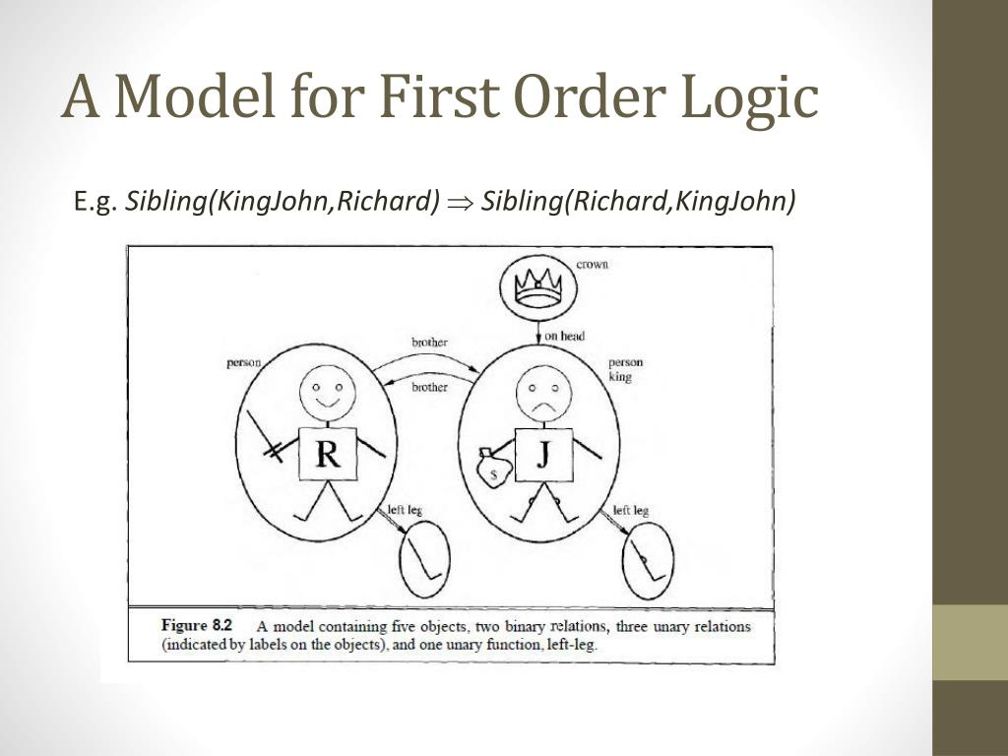

Slide 35
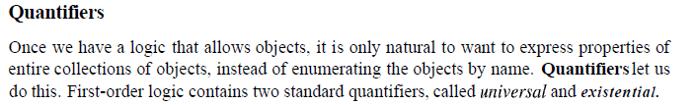
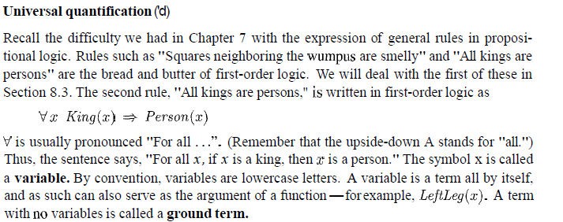
SEMANTICS OF FIRST ORDER LOGIC

Slide 36
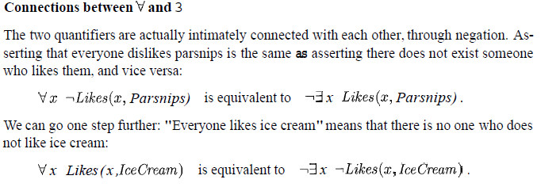

Slide 37
FORWARD CHAINING
Inference Engine
Its is the component of the intelligent system in artificial intelligence which applies logical rules to the Knowledge Base to infer information from known facts.
The first inference engine was part of the expert system. Inference engine commonly proceeds in
two modes,which are:
Forward chaining
Backward Chaining

Slide 38
Horn clause and Definite Clause
Horn clause and definite Clause are the forms of sentences which enables knowledge base to use a more restricted and efficient inference algorithm.
Logical inference algorithms use forward and backward chaining approaches which require KB in the form of the first-order definite clause.
Definite clause: A clause which is a disjunction of literals with exactly one positive literal is known as definite clause or strict horn clause
Horn clause: A clause which is a disjunction of literals with at most one positive literal is known as horn clause .Hence all definite clauses are horn clauses.
Example(negation p V negation q V k).It has only one positive literal

Slide 39
FORWARD CHAINING
It is also called as forward deduction or forward reasoning method when using an inference engine.
The idea is simple: start with the atomic sentences in the knowledge base and apply Modus Ponens in the forward direction, adding new atomic sentences, to extract more data until goal is reached.
It is a bottom up approach..from bottom to top
It is a process of making a conclusion based on known facts or data by starting from initial state and reaches the goal state.
This algm start with known facts
It triggers the entire rules whose premises are satisfied.
Adding their conclusions to the known facts.
The above process repeats until the query is answered or no new facts are called.

Slide 40
Example:
"As per the law, it is a crime for an American to sell weapons to hostile nations. Country A, an enemy of America, has some missiles, and all the missiles were sold to it by Robert, who is an American citizen."
Prove that "Robert is criminal."
To solve the above problem, first, we will convert all the above facts into first-order definite clauses, and then we will use a forward-chaining algorithm to reach the goal.

Slide 41
Facts Conversion into FOL:
It is a crime for an American to sell weapons to hostile nations. (Let's say p, q, and r are variables) American (p) ∧ weapon(q) ∧ sells (p, q, r) ∧ hostile(r) → Criminal(p) ...(1)
Country A has some missiles. ?p Owns(A, p) ∧ Missile(p). It can be written in two definite clauses by using Existential Instantiation, introducing new Constant T1. Owns(A, T1) ......(2) Missile(T1) .......(3)
All of the missiles were sold to country A by Robert. ?p Missiles(p) ∧ Owns (A, p) → Sells (Robert, p, A) ......(4)
Missiles are weapons. Missile(p) → Weapons (p) .......(5)
Enemy of America is known as hostile. Enemy(p, America) →Hostile(p) ........(6)
Country A is an enemy of America. Enemy (A, America) .........(7)
Robert is American American(Robert). ..........(8)

Slide 42
Forward chaining proof:
Step-1:
In the first step we will start with the known facts and will choose the sentences which do not have implications, such as: American(Robert), Enemy(A, America), Owns(A, T1), and Missile(T1). All these facts will be represented as below.

Slide 43
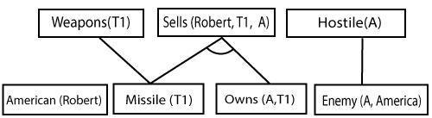
Step-2:
At the second step, we will see those facts which infer from available facts and with satisfied premises.
Rule-(1) does not satisfy premises, so it will not be added in the first iteration.
Rule-(2) and (3) are already added.
Rule-(4) satisfy with the substitution {p/T1}, so Sells (Robert, T1, A) is added, which infers from the conjunction of Rule (2) and (3).
Rule-(6) is satisfied with the substitution(p/A), so Hostile(A) is added and which infers from Rule-(7).

Slide 44
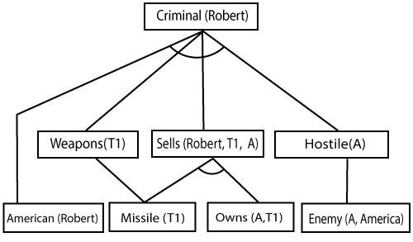
Step-3:
At step-3, as we can check Rule-(1) is satisfied with the substitution {p/Robert, q/T1, r/A}, so we can add Criminal(Robert) which infers all the available facts. And hence we reached our goal statement.
Hence it is proved that Robert is Criminal using forward chaining approach.

Slide 45
Backward Chaining
Backward-chaining is also known as a backward deduction or backward reasoning method when using an inference engine.
A backward chaining algorithm is a form of reasoning, which starts with the goal and works backward, chaining through rules to find known facts that support the goal.
It is known as a top-down approach.
Backward-chaining is based on modus ponens inference rule.
In backward chaining, the goal is broken into sub-goal or sub-goals to prove the facts true.
It is called a goal-driven approach, as a list of goals decides which rules are selected and used.

Slide 46

Backward-Chaining proof:
In Backward chaining, we will start with our goal predicate, which is Criminal(Robert), and then infer further rules.
Step-1:
At the first step, we will take the goal fact. And from the goal fact, we will infer other facts, and at last, we will prove those facts true. So our goal fact is "Robert is Criminal," so following is the predicate of it.

Slide 47
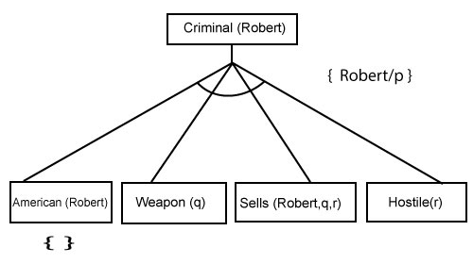
Step-2:
At the second step, we will infer other facts form goal fact which satisfies the rules. So as we can see in Rule-1, the goal predicate Criminal (Robert) is present with substitution {Robert/P}. So we will add all the conjunctive facts below the first level and will replace p with Robert.
Here we can see American (Robert) is a fact, so it is proved here.

Slide 48
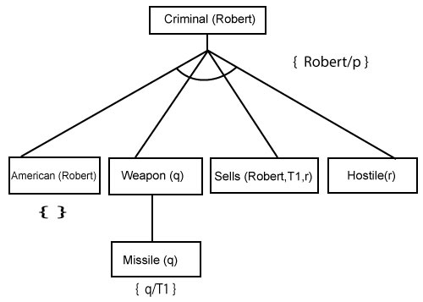
Step-3:t At step-3, we will extract further fact Missile(q) which infer from Weapon(q), as it satisfies Rule-(5). Weapon (q) is also true with the substitution of a constant T1 at q.

Slide 49
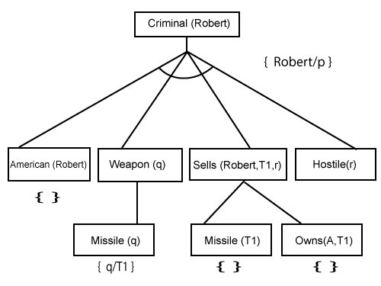
Step-4:
At step-4, we can infer facts Missile(T1) and Owns(A, T1) form Sells(Robert, T1, r) which satisfies the Rule- 4, with the substitution of A in place of r. So these two statements are proved here.

Slide 50
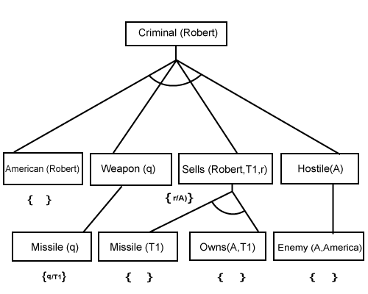
Step-5:
At step-5, we can infer the fact Enemy(A, America) from Hostile(A) which satisfies Rule- 6. And hence all the statements are proved true using backward chaining.

Slide 51
UNIFICATION
It is an algorithm for determining the substitutions needed to make two FOL expressions match
To apply the rule of inference, an inference system must be able to determine when two expressions match, here the unification algorithm used.
The UNIFY algorithm is used for unification, which takes two atomic sentences and returns a unifier for those sentences.

Slide 52
UNIFICATION
FIND the MGU(Most General Unifier)for
Unify{king(x),king(john)}
Let α1=king(x) , α2=king(john),
Substitution ϴ={john/x} is a unifier for those atoms and applying this substitution ,and both expressions will be identical.

Slide 53
Resolution in FOL
Resolution is a theorem proving technique that proceeds by building refutation proofs, i.e., proofs by contradictions.
Resolution is used, if there are various statements are given, and we need to prove a conclusion of those statements.
Unification is a key concept in proofs by resolutions.
Resolution is a single inference rule which can efficiently operate on the conjunctive normal form or clausal form.

Slide 54
RESOLUTION………
Clause: Disjunction of literals (an atomic sentence) is called a clause. It is also known as a unit clause.
Conjunctive Normal Form: A sentence represented as a conjunction of clauses is said to be conjunctive normal form or CNF.

Slide 55
Steps for Resolution
Conversion of facts into first-order logic.
Convert FOL statements into CNF
Negate the statement which needs to prove (proof by contradiction)
Draw resolution graph (unification).

Slide 56
Example: RESOLUTION
John likes all kind of food.
Apple and vegetable are food
Anything anyone eats and not killed is food.
Anil eats peanuts and still alive
Harry eats everything that Anil eats.
Prove by resolution that:
John likes peanuts.

Slide 57
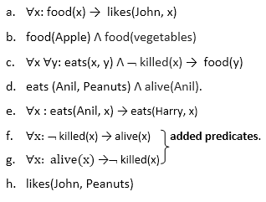
Step-1: Conversion of Facts into FOL
In the first step we will convert all the given statements into its first order logic.

Slide 58
Step-2: Conversion of FOL into CNF
In First order logic resolution, it is required to convert the FOL into CNF as CNF form makes easier for resolution proofs.
Eliminate all implication (→) and rewrite
∀x ¬ food(x) V likes(John, x)
food(Apple) Λ food(vegetables)
∀x ∀y ¬ [eats(x, y) Λ ¬ killed(x)] V food(y)
eats (Anil, Peanuts) Λ alive(Anil)
∀x ¬ eats(Anil, x) V eats(Harry, x)
∀x¬ [¬ killed(x) ] V alive(x)
∀x ¬ alive(x) V ¬ killed(x)
likes(John, Peanuts).

Slide 59
Move negation (¬)inwards and rewrite
∀x ¬ food(x) V likes(John, x)
food(Apple) Λ food(vegetables)
∀x ∀y ¬ eats(x, y) V killed(x) V food(y)
eats (Anil, Peanuts) Λ alive(Anil)
∀x ¬ eats(Anil, x) V eats(Harry, x)
∀x ¬killed(x) ] V alive(x)
∀x ¬ alive(x) V ¬ killed(x)
likes(John, Peanuts).

Slide 60
Rename variables or standardize variables
∀x ¬ food(x) V likes(John, x)
food(Apple) Λ food(vegetables)
∀y ∀z ¬ eats(y, z) V killed(y) V food(z)
eats (Anil, Peanuts) Λ alive(Anil)
∀w¬ eats(Anil, w) V eats(Harry, w)
∀g ¬killed(g) ] V alive(g)
∀k ¬ alive(k) V ¬ killed(k)
likes(John, Peanuts).

Slide 61
Eliminate existential instantiation quantifier by elimination. In this step, we will eliminate existential quantifier ∃, and this process is known as Skolemization. But in this example problem since there is no existential quantifier so all the statements will remain same in this step.

Slide 62
Drop Universal quantifiers. In this step we will drop all universal quantifier since all the statements are not implicitly quantified so we don't need it.
¬ food(x) V likes(John, x)
food(Apple)
food(vegetables)
¬ eats(y, z) V killed(y) V food(z)
eats (Anil, Peanuts)
alive(Anil)
¬ eats(Anil, w) V eats(Harry, w)
killed(g) V alive(g)
¬ alive(k) V ¬ killed(k)
likes(John, Peanuts).

Slide 63
Step-3: Negate the statement to be proved
In this statement, we will apply negation to the conclusion statements, which will be written as ¬likes(John, Peanuts)
Step-4: Draw Resolution graph:
Now in this step, we will solve the problem by resolution tree using substitution. For the above problem, it will be given as follows:

Slide 64
